Slide 1
Helping People Change
Richard Boyatziz, Melvin Smith & Ellen Van Oosten

Slide 2
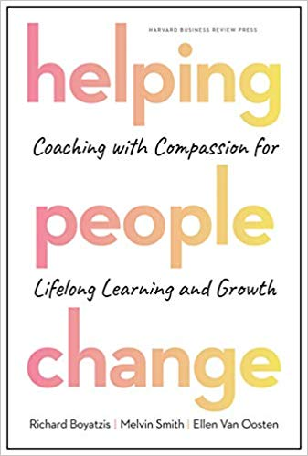
October 2019

Slide 3
The heart of helping
To help people change you need to connect to their positive vision of themselves or a goal they want to achieve.
People draw energy from visions and dreams and this sustains efforts to change even in difficult times.
Problem centred approaches trigger physiological responses that make a person defensive and less open to new ideas.

Slide 4
How to really help people learn and grow
What is the heartfelt desire versus shoulds and oughts?
Evacuating and articulating a personal vision is crucial as it unlocks emotions and intrinsic motivation. This propels people to genuine, lasting change.
UNLIKE trying to help someone achieve a set of prescribed goals or meet certain standards.

Slide 5
As a teacher …
How do you learn and know what your students, direct reports, colleagues are thinking about WHAT MATTERS TO THEM?
We can become pre-occupied with tasks and forget to ask basic questions. Are we afraid of what issue and emotions might surface?
We might simply proceed, undeterred by peoples needs and issues.

Slide 6
We can’t FIX people!
Often when we try to help someone we focus on correcting a problem.
If they change this will often be through a sense of obligation and not inner motivation.
Q: Does the person have a deep commitment towards change?
Coaching for compliance is often a default approach, it is instructional but rarely leads to sustained change.
Coaching with compassion, with a focus on the coachees agenda provides a process and the support to make SUSTAINED change.
(What at Leadeship Edge we call PURE coaching!)

Slide 7
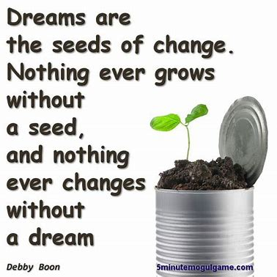
Planting seeds of inspiration
“ All those that were important figures in my life planted seeds of inspiration and ideas that then allowed me the freedom to take that in directions that worked best for me, all the while supporting and encouraging my choices.” (p7)
A great coach makes us want to grow, develop and change in meaningful ways, to have a positive vision rather than a sense of duty.

Slide 8
THE RESEARCH why coaching with compassion works
There comes a tipping point!
The coaching process needs to be holistic, encompassing the whole of life not just a few discrete aspects.
BUT to be good coach we need to understand our own emotions and develop our own personal vision.

Slide 9
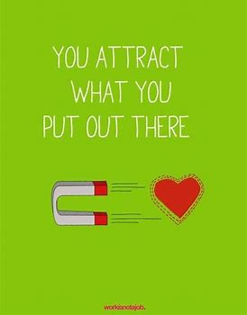
THE RESEARCH why PURE coaching works
The authors research over 50 years at Case Western University, backed by Harvard and the Coaching Research Lab make the case clearly, the behavioural, hormonal and neuro-imaging, show the difference impact of coaching for compassion v coaching for compliance.
When combined with a leadership development programme result in significant improvement towards their personal vision.

Slide 10
THE RESEARCH The scientific foundation for the development of how to effectively coach
There is a message of hope.
The way to energise and inspire people to learn and change in sustained ways is not difficult; it may seem counter intuitive at times.
So what do effective coaches do to stimulate a person to explore new ideas?
What does it feel like to be engaged in a meaningful coaching relationship?
How can we lead in more compassionate ways?

Slide 11
Conversations that inspire discovering what is most important
Coaching when it is most effective, is essentially helping and other person, change, learn or grow in someway. It is helping people to figure out what might to possible or desired in their lives and then helping to figure out how to achieve it.
Who are the people that have helped you most in your life?
Great coaches ignite a deep sense of meaning and hope, at its best it is like having a relaxed conversation with a close friend.

Slide 12
Coaching for Compliance
Even when it is well intentioned, this can elicit a defensive response from the person being coached. This can often be a stress response accompanied by negative emotions and activation of the of the sympathetic nervous system, which in turn triggers a number of hormonal processes that essentially shut down the ability to learn or change in any way.
People are in survival mode. Their creativity and openness to new ideas are greatly diminished.

Slide 13
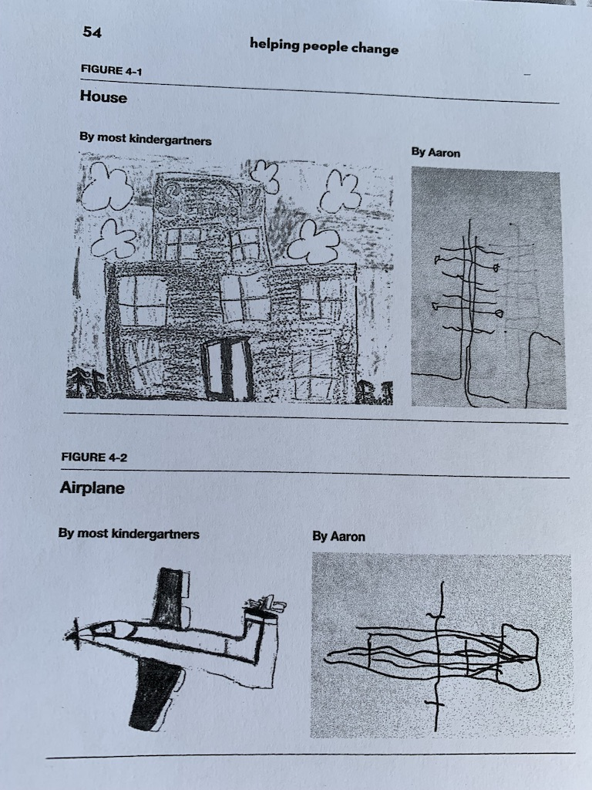
Aaron’s drawings (p54)
Aaron was a 5 year old, his teacher asked the class to draw a picture of a house, later she asked the children to draw an aeroplane.
Aaron’s teacher showed the Head Aaron’s pictures and they agreed that maybe his rluctance seen in class and this evidence meant that there was evidence of emotional troubles or a learning disability. His parents were called in.
The teacher didn’t say she was trying to get Aaron to write with his right hand and he was resisting.
The school had aroused the fears in the parents, that maybe there was something wrong with their child. School made the decision that Aaron would be assigned to a new special needs class.

Slide 14
Aaron’s drawings (p54)
When they got home Aaron was delighted to see his parents had his two pictures.
With a smile, his dad said they loved his pictures and asked his son what he saw and why he drew the pictures the way he did.
Aaron eagerly pointed to the lines in the house and aeroplane “You can’t have a building without electricals and plumbing or a plane without hydraulics and the electrical system, if I drew the outside first you would never see the important stuff inside.”
Aaron’s thinking was far more complex that the average 5 year old.

Slide 15
Put the focus on them, not us!
We have to understand our coachee/ employee, it is not our vision of how things should be. We have to discover how they feel as well as think. This is often assumed.
As coaches we have to ask questions that awaken the PEA (Positive Emotional Attractor) and trigger hormones in the parasympathetic nervous system, such as joy, gratitude and curiosity.
Good questions open up possibilities. We ask people to articulate their thinking, anchoring them in the PEA.
With Aaron, his teachers had failed to ask him for his reasoning. Schools are framed perceived as an “Expert” system, with educators knowing more about the process than parents and learners. Historically this has not worked well in education and does not work well in coaching.

Slide 16
Research spotlight
Chronic stress, such as working for a demanding or toxic boss, causes your body to activate and prepare to defend itself but also results in cognitive, perceptual and emotional impairment.
In contrast the PNS (parasympathic nervous system) activates the renewal processes, including positive hormones oxytocin (females) and vasopressin (males)They are VASOLDILATERS. They open up blood flow, you feel warmer, your blood pressure and pulse rates drop, your breathing slows down. You engage your immune system to its fullest capacity.
Without renewal, chronic stress will make your functioning and performance unsustainable.

Slide 17
Research spotlight: Boyatziz: A neuroscience study of coaching
Two coaches were selected to support 20 sophomores (19/20 year olds) ten were male and ten female.
They had a 30 minute coaching conversation with one coach and then next day another 30 minute conversation with the other coach.
One coach was asked to use a PEA (positive emotional attractor)approach and the other a NEA approach.
During the PEA session students were asked “if your life was perfect in ten years time, what would it look like?”
In the NEA session they were asked four questions about their course; how are you doing? Are you doing all the assignments? All the reading? Are you getting enough time from your tutor?

Slide 18
Research spotlight: Boyatziz: A neuroscience study of coaching
The NEA questions were not negative but were classed as NEA because they typically evoked feelings of guilt, inadequacy and frustration.
After the sessions (which were in a random order of PEA or NEA coaching) students were asked about the two coaches.
The PEA coach was seen as inspiring and caring, the other as making them feel guilty and self conscious.
The body’s stress response is part of the NEA and the renewal process is part of the PEA. Learning to recognise the moments of renewal help us to maintain the all important balance between stress and renewal, so does variety and change.

Slide 19
A personal vision
A personal vision is holistic, a comprehensive expression of the ideal self and the ideal future, it includes dreams, a sense of calling, passion, purpose and core values.
It should be more like a visual dream that goals.
It should be highly important and meaningful to the person.
Some aspects will change during phases of your life, often a
sense of purpose and core values will remain the same.

Slide 20
Cultivating a resonant relationship
Inspiring, meaningful coaching moments and high quality coaching relationships don’t just happen. They take intention, preparation and practice.
These relationships are at the centre of the phases of sustained, desired change and the transition from one phase to another. It is a non-linear and uneven process.
There are 3 structural dimensions:
(Dutton and Heaphy p130)
Emotional Carrying Capacity, tensility and a degree of connectivity

Slide 21
The three structural dimensions
Emotional Carrying Capacity: Allows a full range of positive and negative emotions to be shared.
Tensility: The capacity of the connection to adapt and bounce back through the various situations and contexts.
A degree of connectivity: The extent to which the connection encourages openness and generation of new ideas.

Slide 22
The three cornerstones of coaching
Believe that individual change is a process, not an event.
Consider your approach to coaching as a chance to mine for gold not dig for dirt.
The agenda for the conversation should come from the person being coached.

Slide 23
The three cornerstones of coaching
Believe that individual change is a process, not an event.
Consider your approach to coaching as a chance to mine for gold not dig for dirt.
The agenda for the conversation should come from the person being coached.

