Slide 1
Fearless Leadership
Carey D. Lohrenz

Slide 2

Aviation pioneer Carey D. Lohrenz
“Fearless leadership isn’t about not feeling fear. It’s having the ability to feel uncomfortable and to move through it and show up to be the best you can be,”

Slide 3
Fearless leadership
Aviation pioneer Carey D. Lohrenz learned what Fearless Leadership means in two of the most demanding and extreme environments imaginable: the cockpit of an F-14 and the flight deck of an aircraft carrier. Through her experiences, Lohrenz identified a fundamental truth: High performing teams require fearless leaders.

Slide 4
The fundamentals of
Fearless Leadership
Courage: If you cultivate courage in yourself, you’ll have what it takes to see limitless possibilities for yourself as a leader.
• Tenacity: Embracing the persistence it takes to keep going after a goal—even when it becomes difficult or risky—and continuing to take action.
• Integrity: Do the right thing, be honest, be trustworthy, and lead by example.

Slide 5
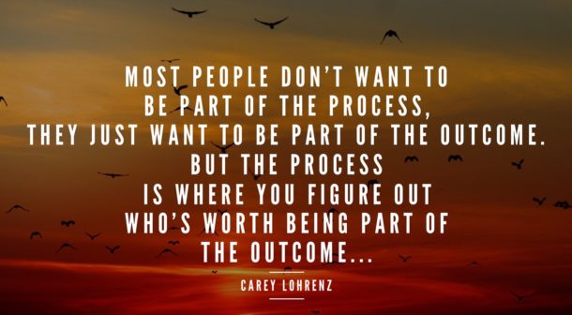

Slide 6
Success and High Performance
Success requires leadership that sets a clear vision and defines what success looks like.
While high performance requires teammates who push you beyond what you thought was possible. Teammates who strive for excellence together, share both successes and mistakes.
Teammates are not afraid to do the work!

Slide 7
World Class Teamwork
World class teamwork, communication, collaboration, trust and shared learning are critical components of a high performing team. We never reach the top alone, and teamwork has a dramatic effect on our results and performance.

Slide 8
Interconnected and dependent
Successful teamwork requires that we realise we are all interconnected, and dependent on our teammates judgements and performance.
Teamwork begins to happen when you realise you can’t go it alone, that in order to achieve your goals, whether personal or professional, you’ll need the support of great teammates.

Slide 9
Whose job is it?
Well, that would be you. It is your job.
No matter what our roles are in life, we all engage in leadership and teamwork every day.
And though it may be tempting to think teamwork will magically happen on its own, know how and why you do what you do.
And then be willing to grind it out. Align your words and actions.
Be bold, be fearless, be accountable, do the work.
Be a good teammate!

Slide 10
Fearless Leadership into action
First set a clear vision, then be the catalyst for moving your team toward that vision by creating the culture to support it.
She also illustrates the importance of being resilient as a leader and describes the seven steps you can take to become more resilient:

Slide 11
7 Steps to Fearless Leadership
Reject victimhood
Embrace change
Focus on what matters
Find a wingman
Know what you can control
Learn from adversity
Take action

Slide 12
Driving Success
“Above all, Fearless Leadership is the difference between having the life, team, culture, and organisation that you want, and settling.”
So risk more, worry less, and take action—because bold, fearless action drives success.

